Slide 1
GOVT. COLLEGE ROPAR
DEPATMENT OF ECONOMICS
TOPIC: MONEY MARKET AND CAPITAL MARKET
  INTRODUCTION
  DEFINITION
  STRUCTURE OF MONEY MARKET & CAPITAL MARKET
  DIFFERENCE BETWEEN MONEY MARKET AND CAPITAL MARKET
  CONCLUSION
SEMESTER: 4th class : b.a (2ND YEAR)
PROF: RITU SACHDEVA

Slide 2
INTRODUCTION
Money market is a very important segment of a financial system. Monetary assets of short-term nature up to one year and financial assets that are close substitutes for money are dealt in the money market. Money market instruments have the characteristics of liquidity (quick conversion into money), minimum transaction cost and no loss in value. Excess funds are deployed in the money market, which in turn is availed of to meet temporary shortages of cash and other obligations. Money market provides access to providers and users of short-term funds to fulfill their investments and borrowings requirements respectively at an efficient market clearing price.
A capital market is a financial market in which long-term debt or equity-backed securities are bought and sold, in contrast to a money market where short-term debt is bought and sold. Examples of capital markets include the London Stock Exchange or the New York Stock Exchange. There are many different types of capital markets.
Equity capital markets are a broad network of financial institutions and markets that assist companies in raising capital, perhaps to fund the expansion of a company. Typically, this is done by an IPO (initial public offering). Once listed, a company’s shares are bought and sold by investors, leaving the price of shares to market forces.

Slide 3
DEFINITION
The money market refers to trading in very short-term debt investments. At the wholesale level, it involves large-volume trades between institutions and traders. At the retail level, it includes money market mutual funds bought by individual investors and money market accounts opened by bank customers.
Capital market is a market where buyers and sellers engage in trade of financial securities like bonds, stocks, etc. The buying/selling is undertaken by participants such as individuals and institutions

Slide 4
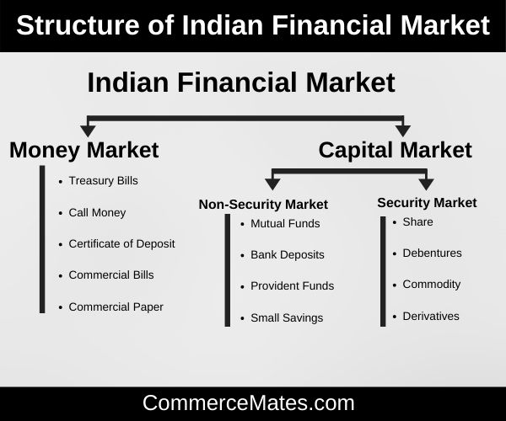
STRUCTURE

Slide 5
DIFFERENCE BETWEEN MONEY AND CAPITAL MARKET
Money Market | Capital Market
Definition
A random course of financial institutions, bill brokers, money dealers, banks, etc., wherein dealing on short-term financial tools are being settled is referred to as Money Market. | A kind of financial market where the company or government securities are generated and patronised with the intention of establishing long-term finance to coincide with the capital necessary is called Capital Market.
Market Nature
Money markets are informal in nature. | Capital markets are formal in nature.
Instruments involved
Commercial Papers, Treasury Certificate of Deposit, Bills, Trade Credit, etc. | Bonds, Debentures, Shares, Asset Secularisation, Retained Earnings, Euro Issues, etc.
Investor Types
Commercial banks, non-financial institutions, central bank, chit funds, etc. | Stockbrokers, insurance companies, Commercial banks, underwriters, etc.
Market Liquidity
Money markets are highly liquid. | Capital markets are comparatively less liquid.

Slide 6
CONCLUSION
SO WE CAN SAY THE MONEY MARKET INSTRUMENT IS THE MARKET FOR MONEY ,PLAYERS IN THE MARKET HAVE TO BE ALERT TO CHANGES,UP TO DATE WITH NEWS AND INNOVATIVE WITH STRATEGIES AND PRODUCT.
ON THE OTHER HAND,CAPITAL MARKETS ARE GENERALLY LESS LIQUID BUT PROVIDE GOOD RETURNS AT HIGHER RISK WHEREAS MOEY MARKETS ARE HIGHLY LIQUID BUT PROVIDE LOWER RETURN.

Slide 7
THANKS

